Slide 1



CodeFury Contest
HOSPITAL MANAGEMENT SYSTEM
BY TEAM- SYNTAX SQUAD

Slide 2

Meet Our Team
Jathin - Team Lead
Anshu Aditya
Kavya Sri Vani
Yogesh Modi
Sahithi
Rohith Kumar
Pragya Saini

Slide 3

About
The Hospital Management System streamlines hospital operations by automating tasks like patient registration and appointment scheduling. It enhances efficiency, reduces errors, and improves care quality by providing an integrated platform for administrators, doctors, and patients.

Slide 4
System Architecture
The Hospital Management System architecture is structured into key layers:
Presentation Layer (Frontend): User-friendly interfaces for administrators, doctors, and patients, built with HTML, CSS, and JavaScript for responsive design.
Application Layer (Backend): Core logic developed in Java and Servlets, handling user requests, business processes, and data interactions.
Data Layer (Database): SQL-based relational databases store patient records, appointments, and user credentials, ensuring data integrity.
Integration Layer (APIs & Services): Facilitates interoperability with external systems, enabling seamless data exchange.
Security Layer: Implements encryption, secure login, and role-based access to protect sensitive data and ensure compliance.

Slide 5
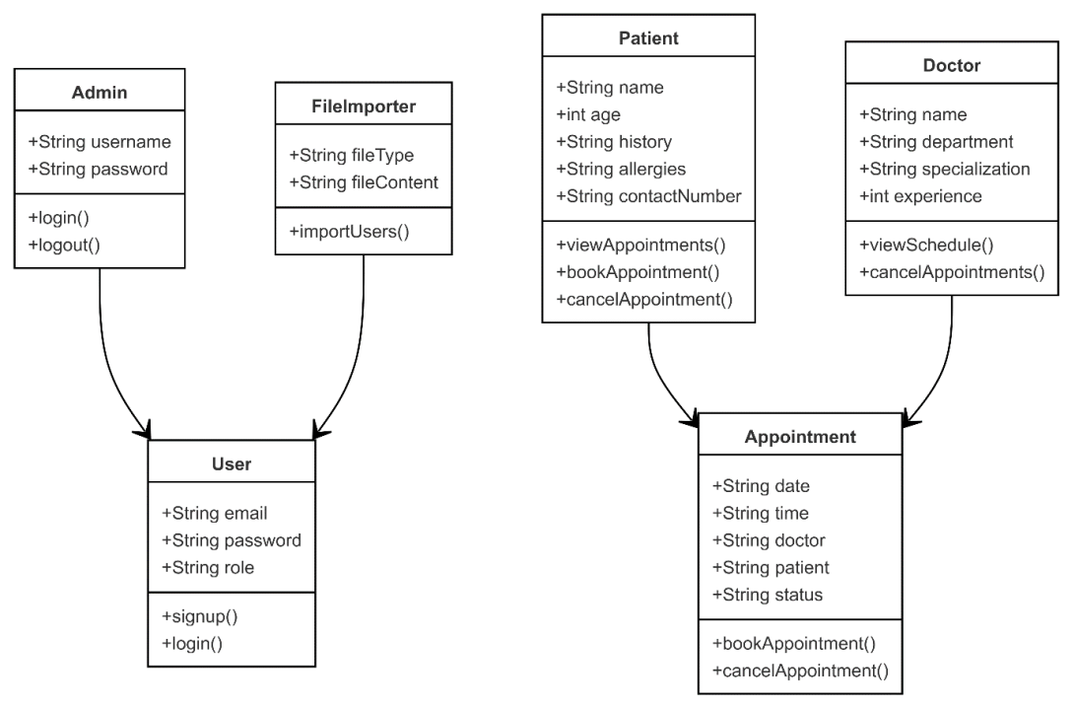
Class Diagram

Slide 6
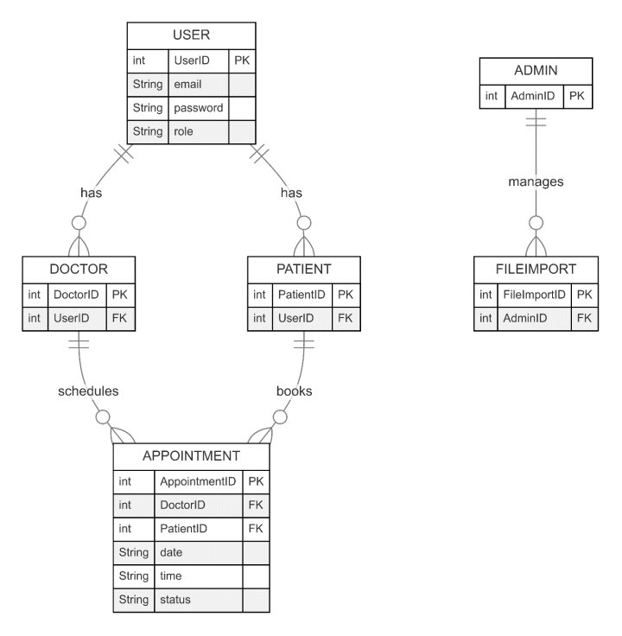
ER DIAGRAM

Slide 7
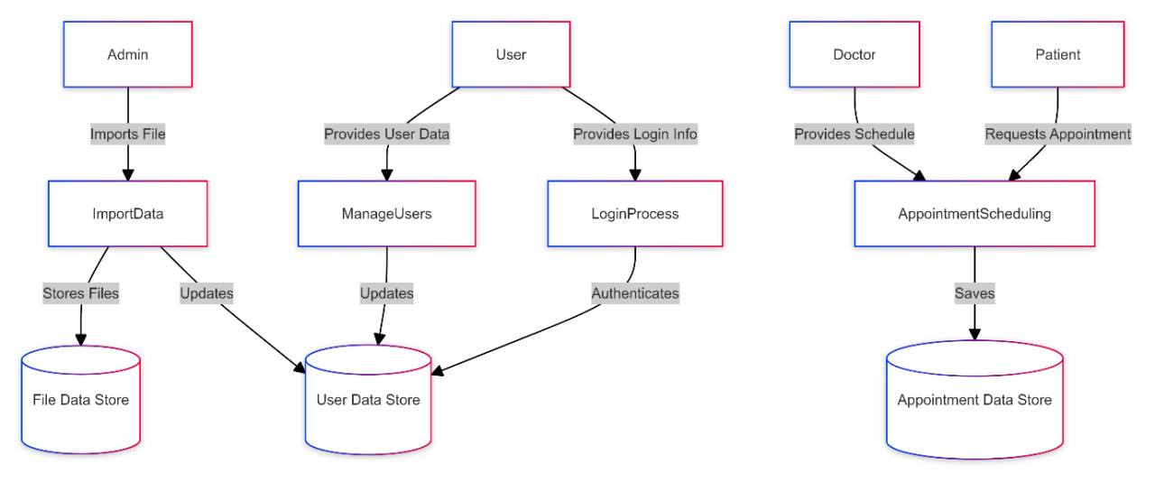
DATAFLOW DIAGRAM

Slide 8
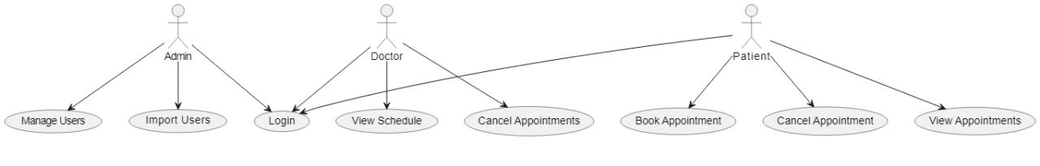
USECASE DIAGRAM

Slide 9
Key Modules in hospital Management System
The Hospital Management System integrates several key modules to streamline hospital operations:
User & Appointment Management: Admins manage user accounts and roles, while doctors and patients handle profiles, schedules, and bookings. Patients can book, view, and cancel appointments with real-time updates.
Medical Records: Comprehensive patient records, including medical history and treatment details, are securely stored and accessed by authorized personnel.
Authentication & Security: The system ensures secure login, role-based access, and data protection through encryption and controlled access.
Notifications: Real-time alerts keep users informed about appointments and important updates, enhancing responsiveness and engagement.
System Administration: Admins can monitor system performance, configure settings, and ensure regular backups and recovery for data integrity.

Slide 10
User Dashboard

Slide 11
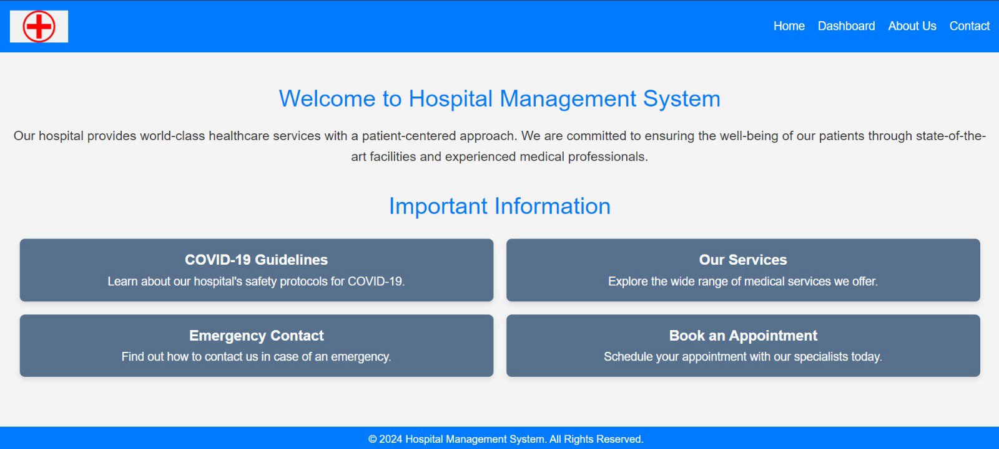
This is the Welcome page of our Project which has some Important Information and a Welcome note.

Slide 12
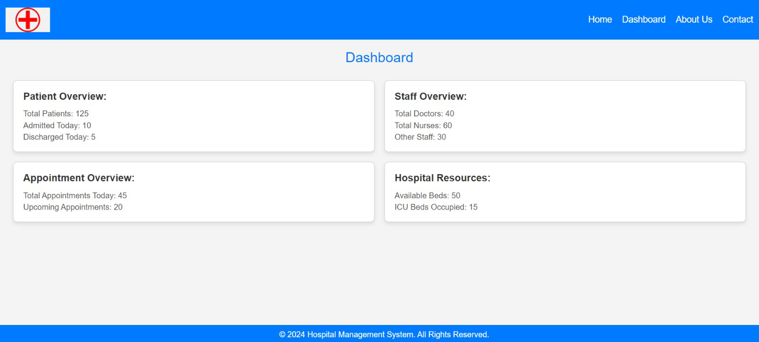
This is the Dashboard page. Upon clicking on the Dashboard option on the top right you can access this page. This consists of details related to Staff, Patients, Appointment Details and other resources details.

Slide 13
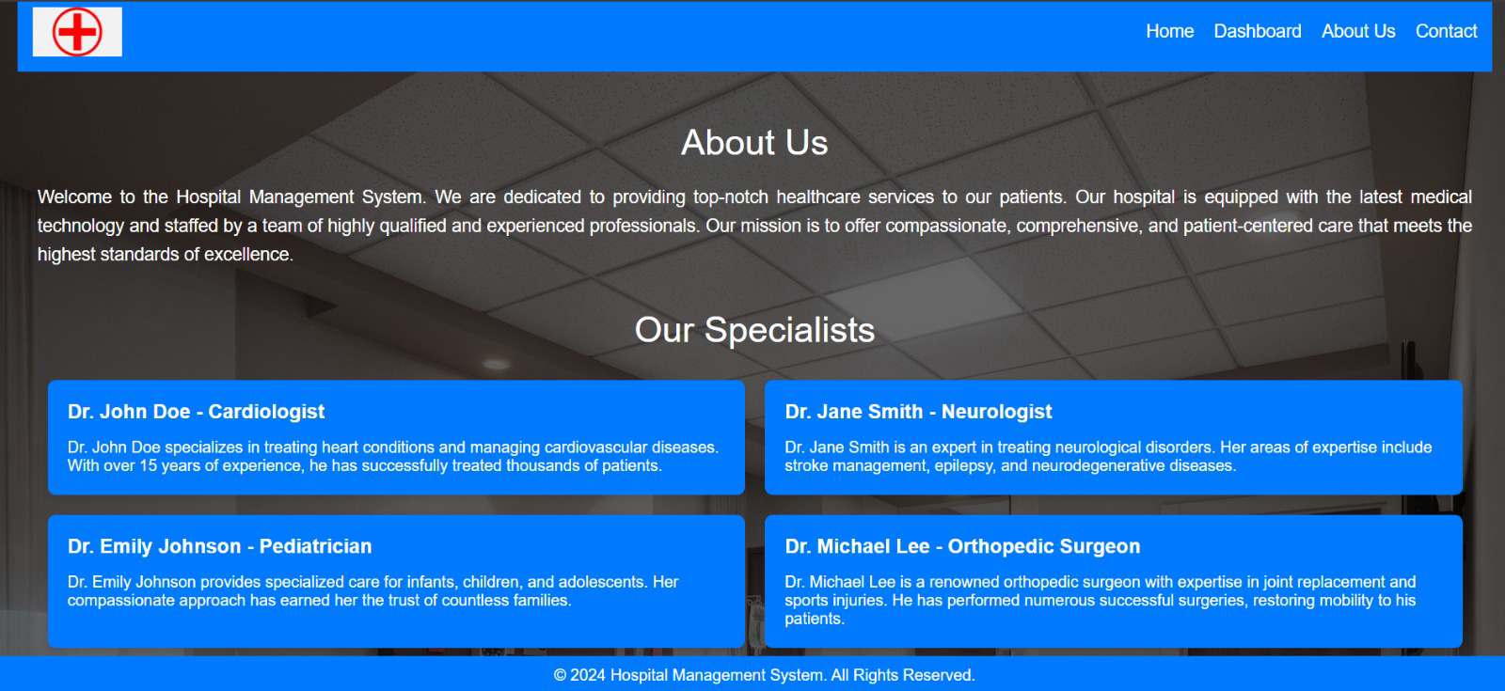
About Us page gives the overview of the doctors and the basic details of them like their specializations and all.

Slide 14
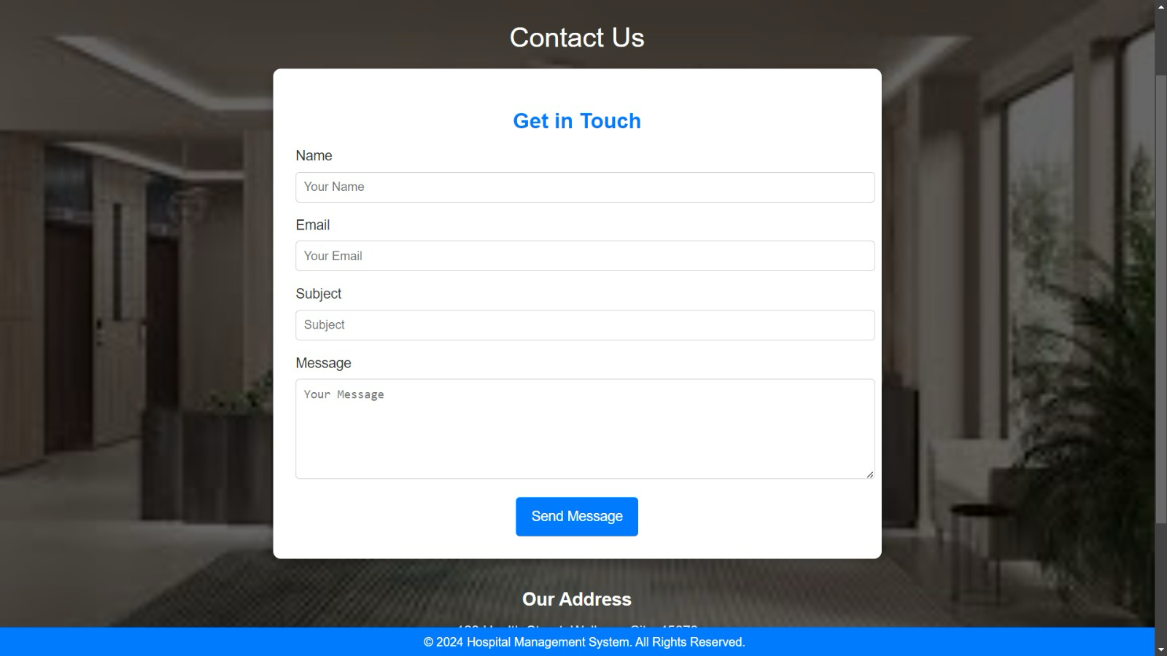
If a person wanted to get in touch with the hospital management, they can fill in the details in this form.

Slide 15
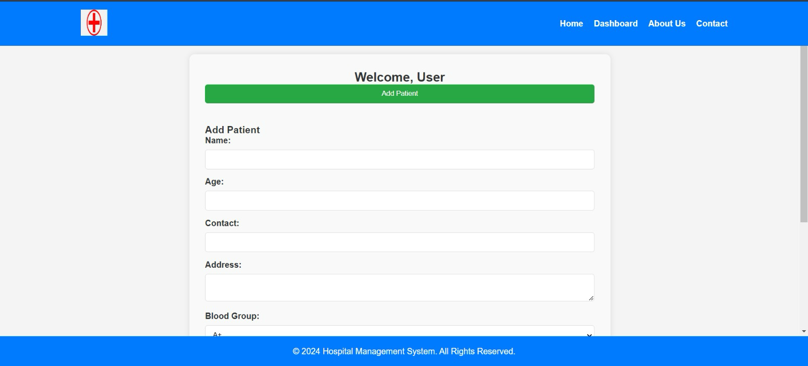
Through this page we can add the patient details and can add them into the records.

Slide 16
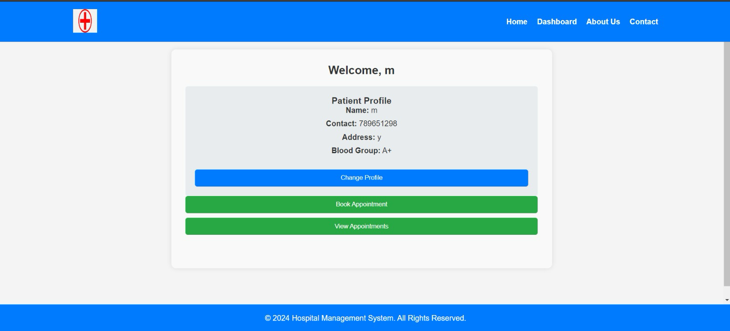
This page presents the patients basic details such as name, contactm address and blood group. They can book appointments through this page. User can edit the details of the profile here.

Slide 17
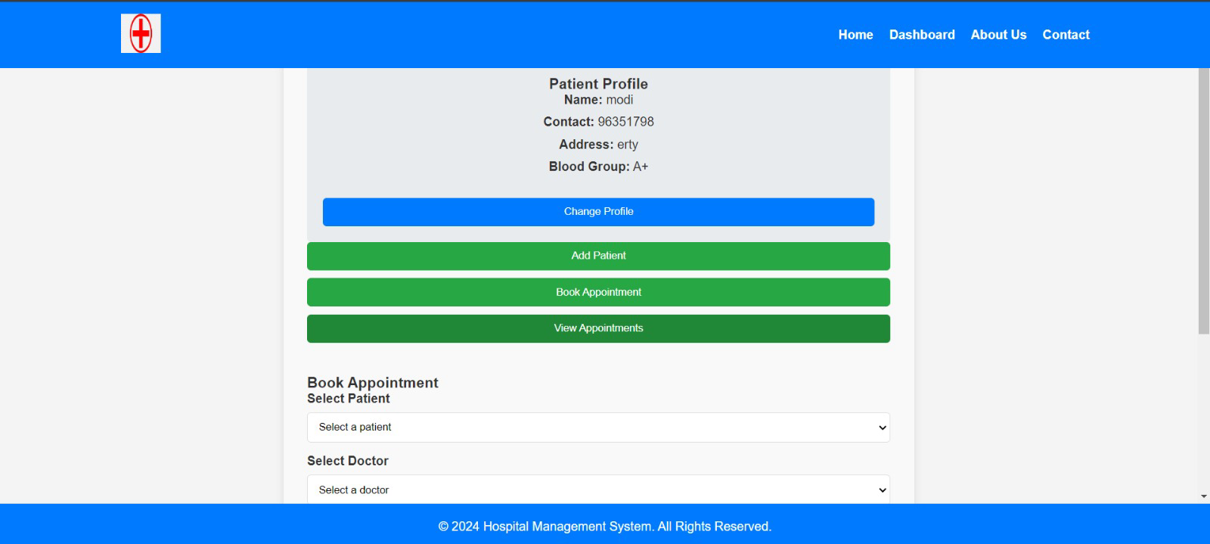
Upon clicking the book appointment button, we are required to select the patient, the doctor they wanted to consult, the date and time of appointment as well

Slide 18
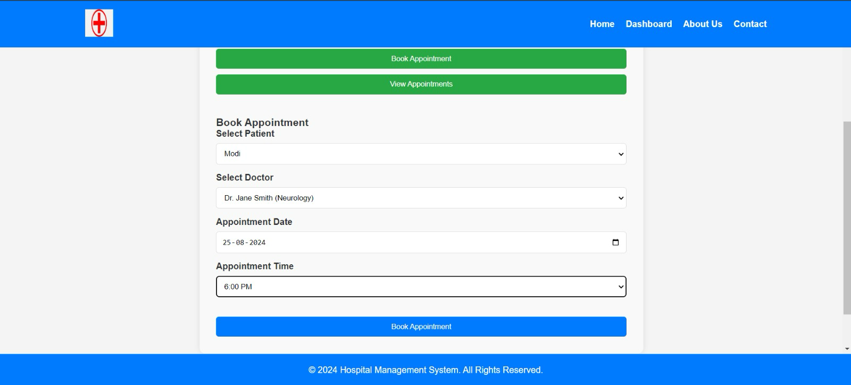
After filling the details in their respective fields, User needs to just click on Book Appointment button.

Slide 19
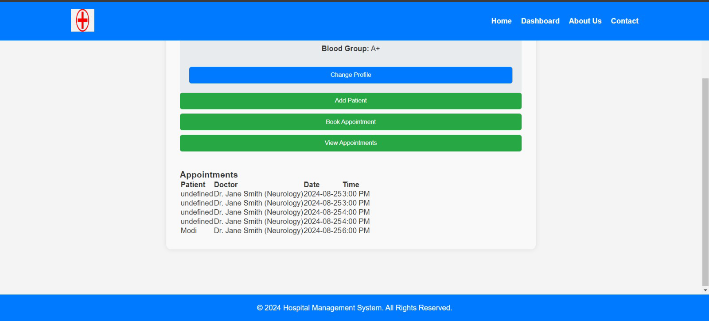
By following the previous steps one can book their appointment and that will be reflected in the profile page.

Slide 20
Doctor Dashboard

Slide 21
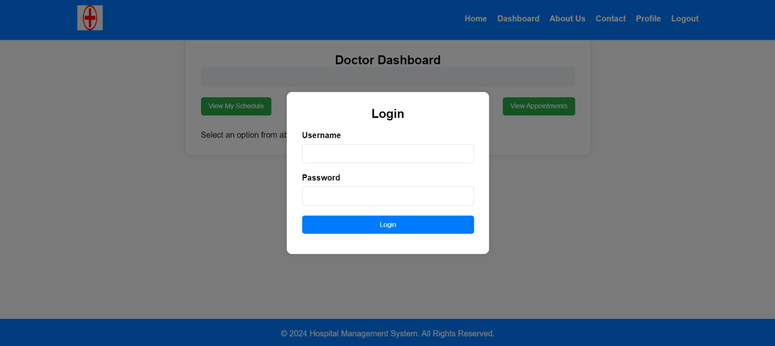
This is the Doctor’s Login Page.

Slide 22
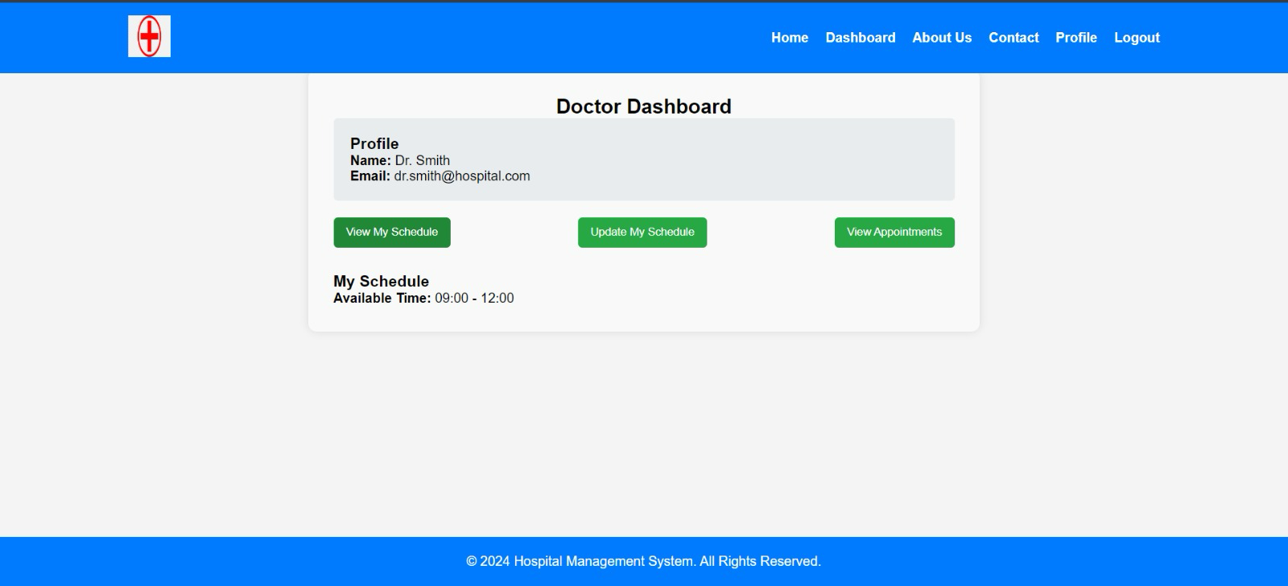
Doctor will have the options related to their schedules, and the appointments if they have any.

Slide 23
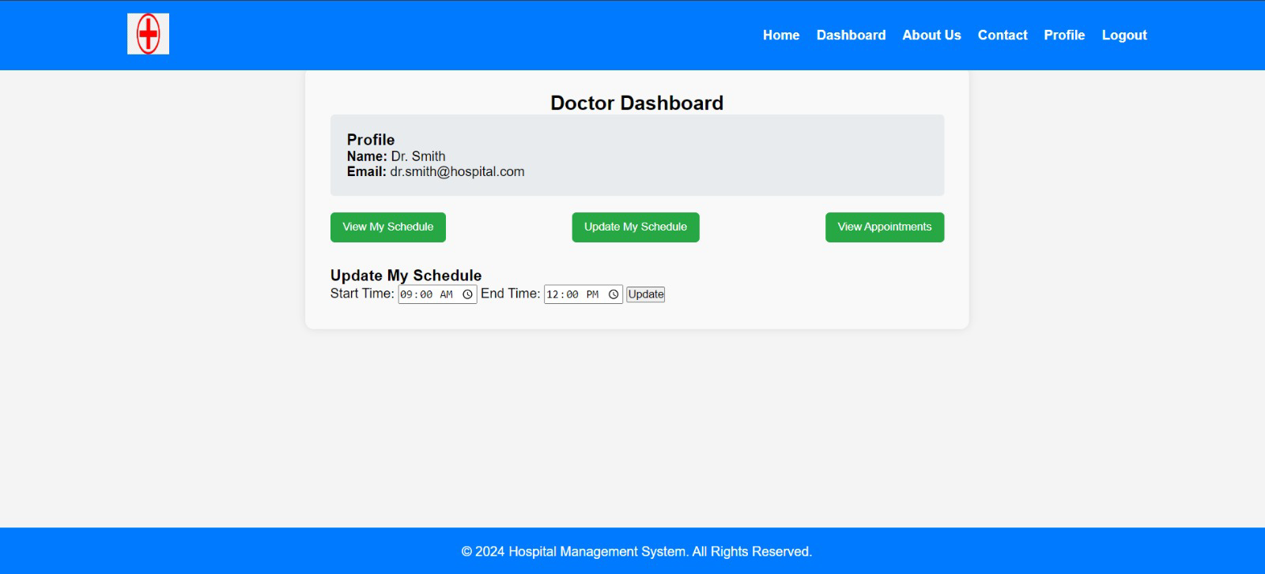
They can also update their schedules based on their free time and other priorities.

Slide 24
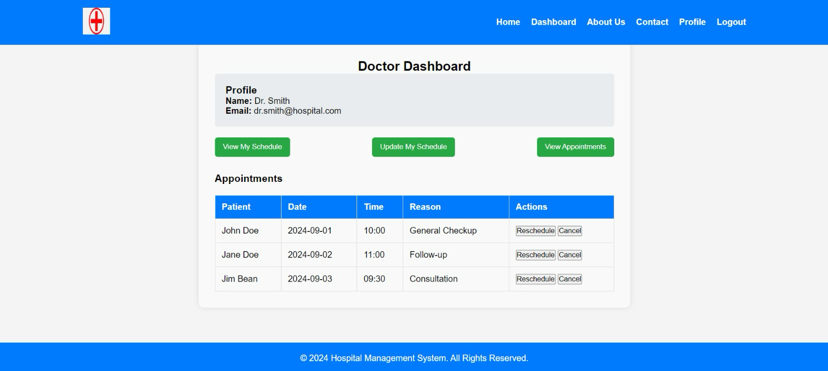
By clicking on the view appointments button, doctor can view all the appointments and they can also reschedule if they wish to.

Slide 25
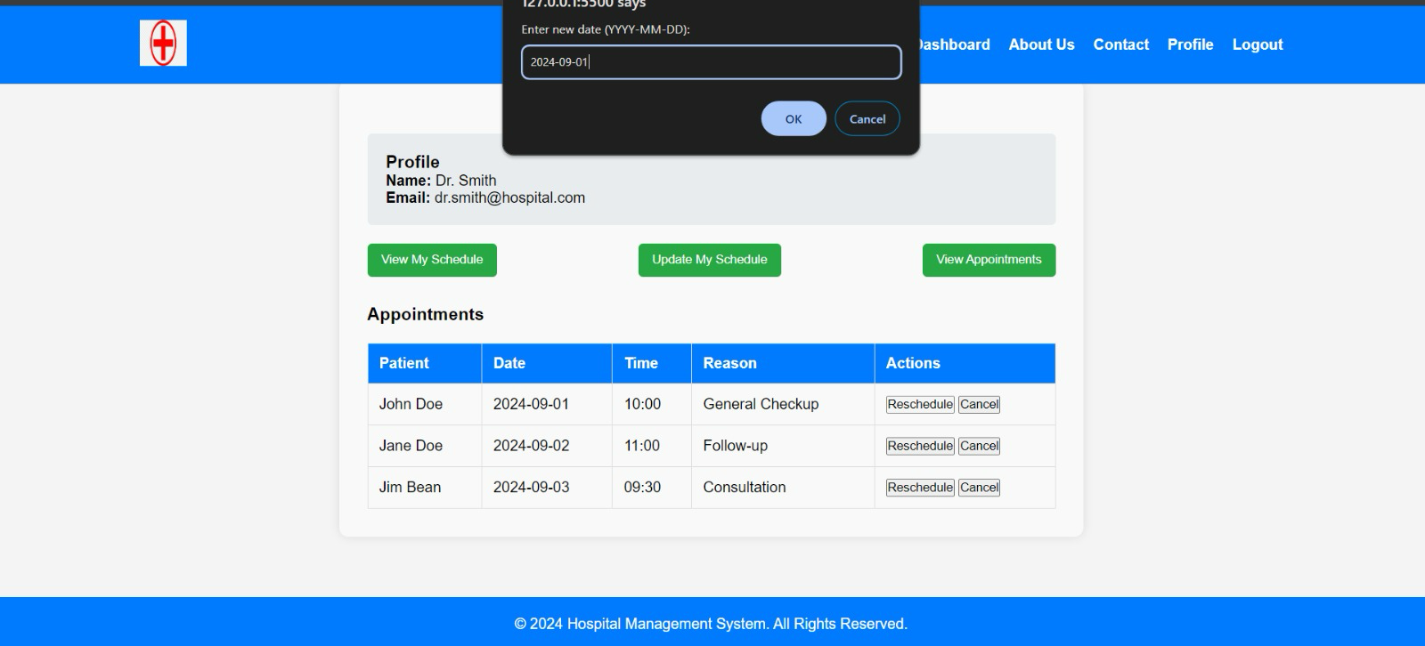
if they wish to reschedule, they can enter the new dates here.

Slide 26
Admin Dashboard

Slide 27
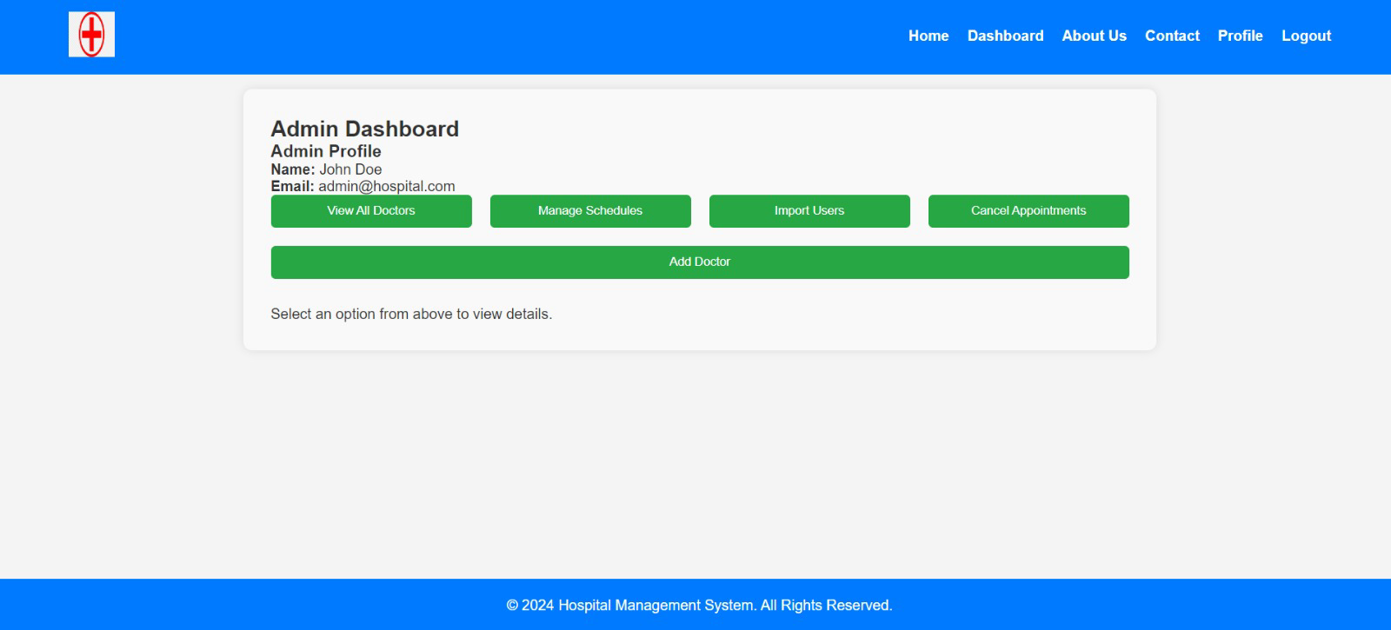
This is the admin dashboard. Through this we can add the doctors, manage the doctors, users and their appointments.

Slide 28
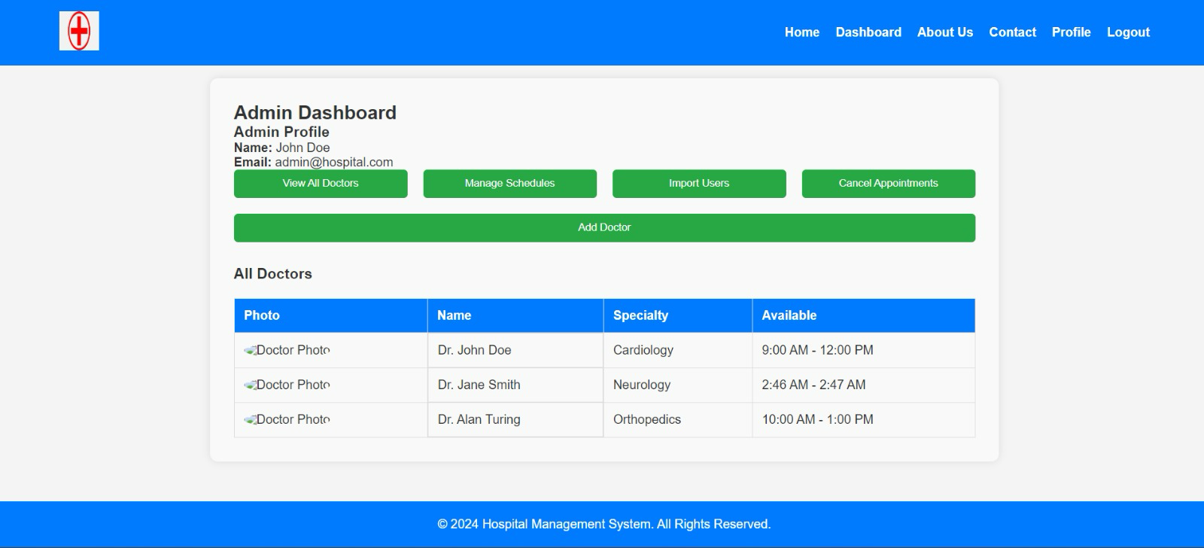
In this Admin dashboard, upon clicking the view doctors option, admin can access the details of all the doctors present.

Slide 29
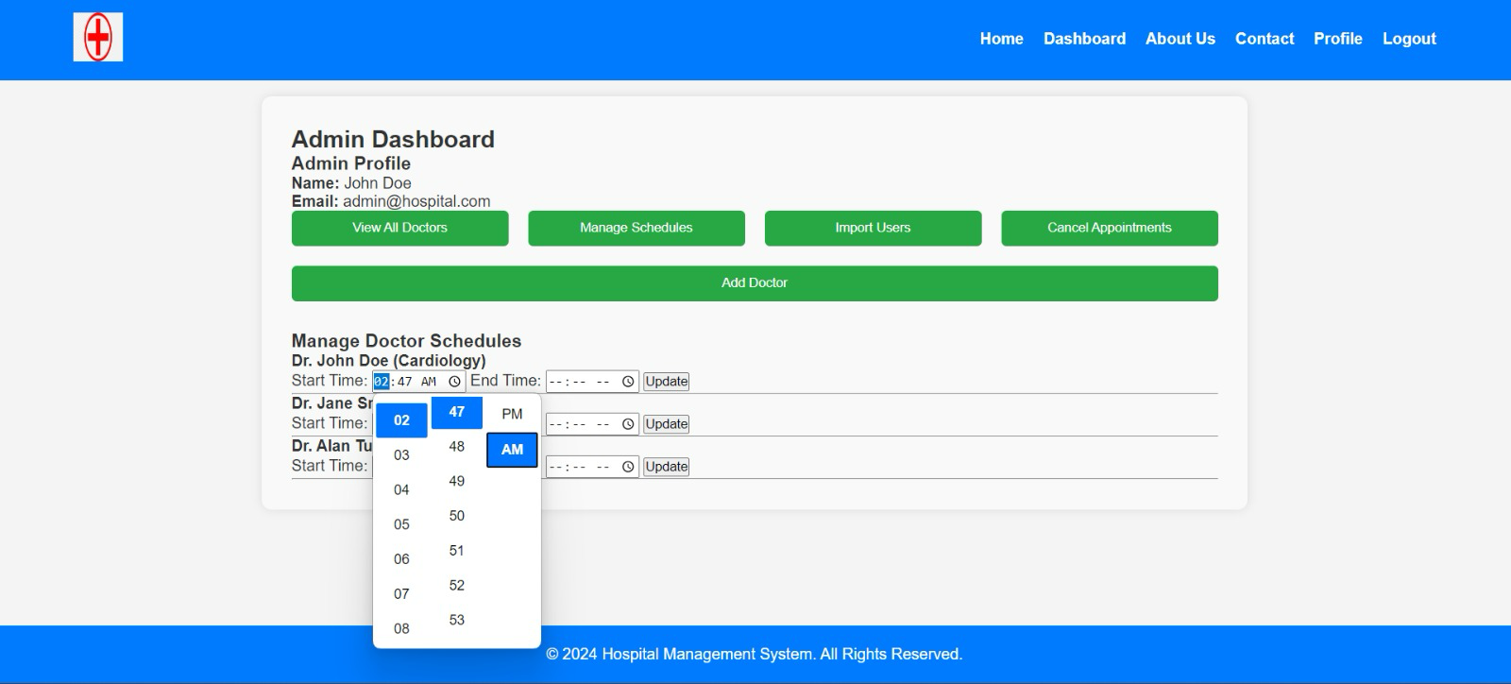
Admin also has the access to manage the doctors schedule.

Slide 30
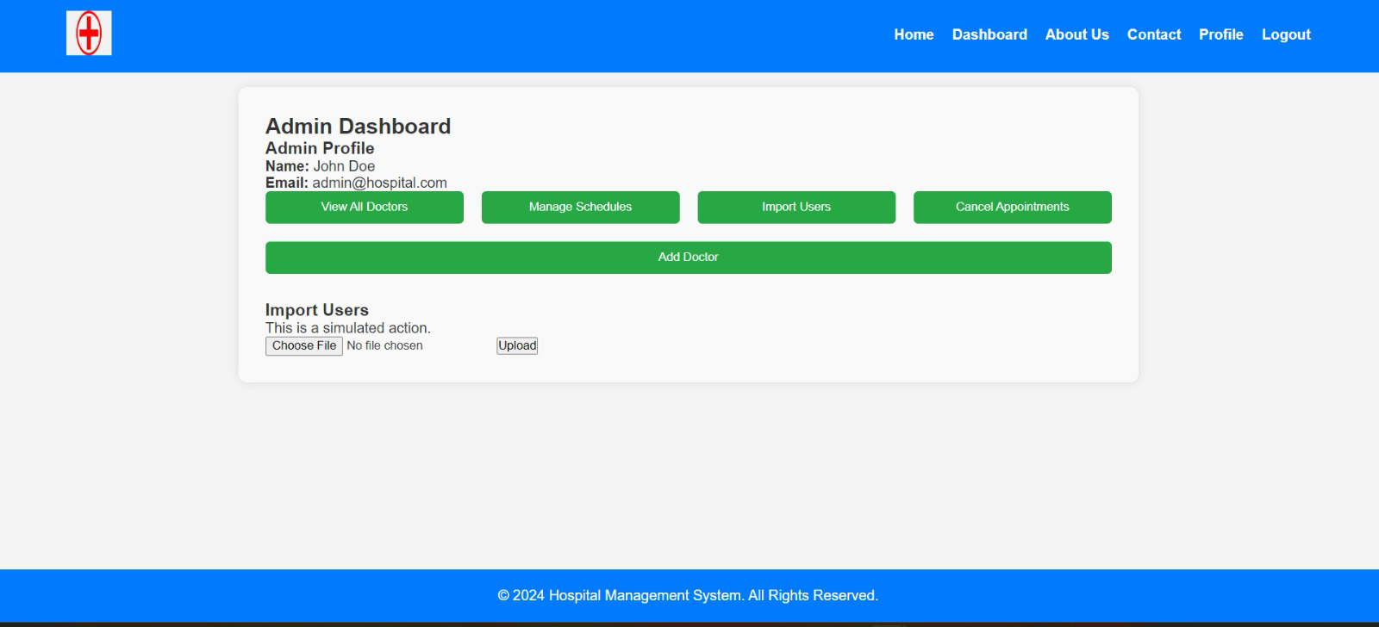
Admin can also Import users.

Slide 31
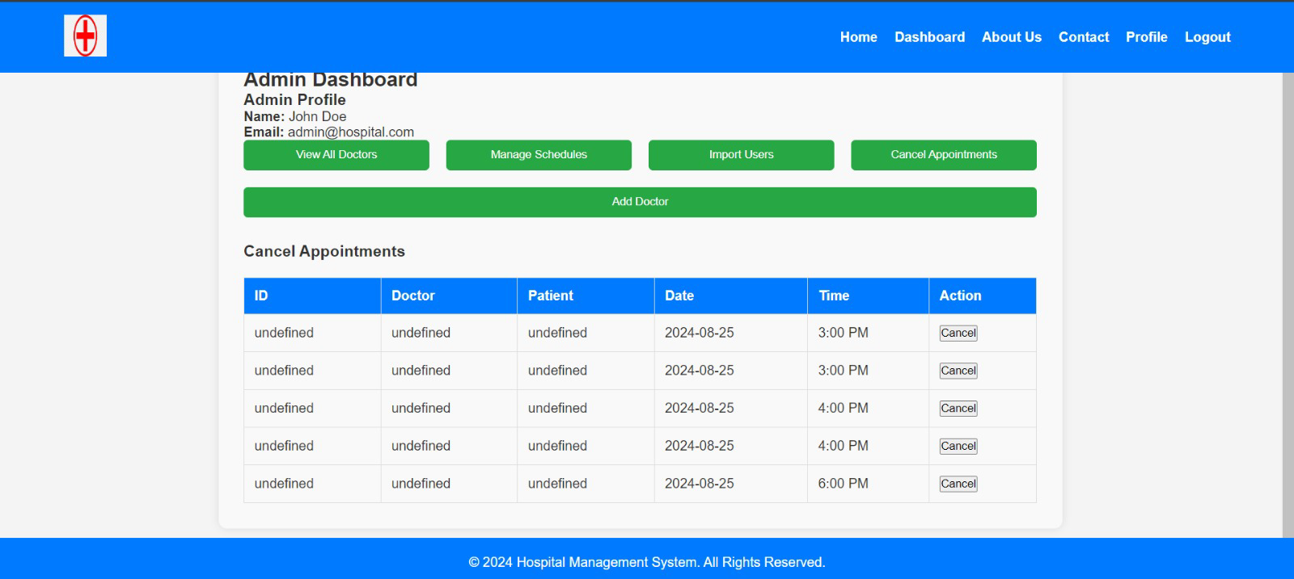
Admin also have the access to cancel the appointments from his side bu just clicking on Cancel Appointments and the clicking on the cancel button.

Slide 32
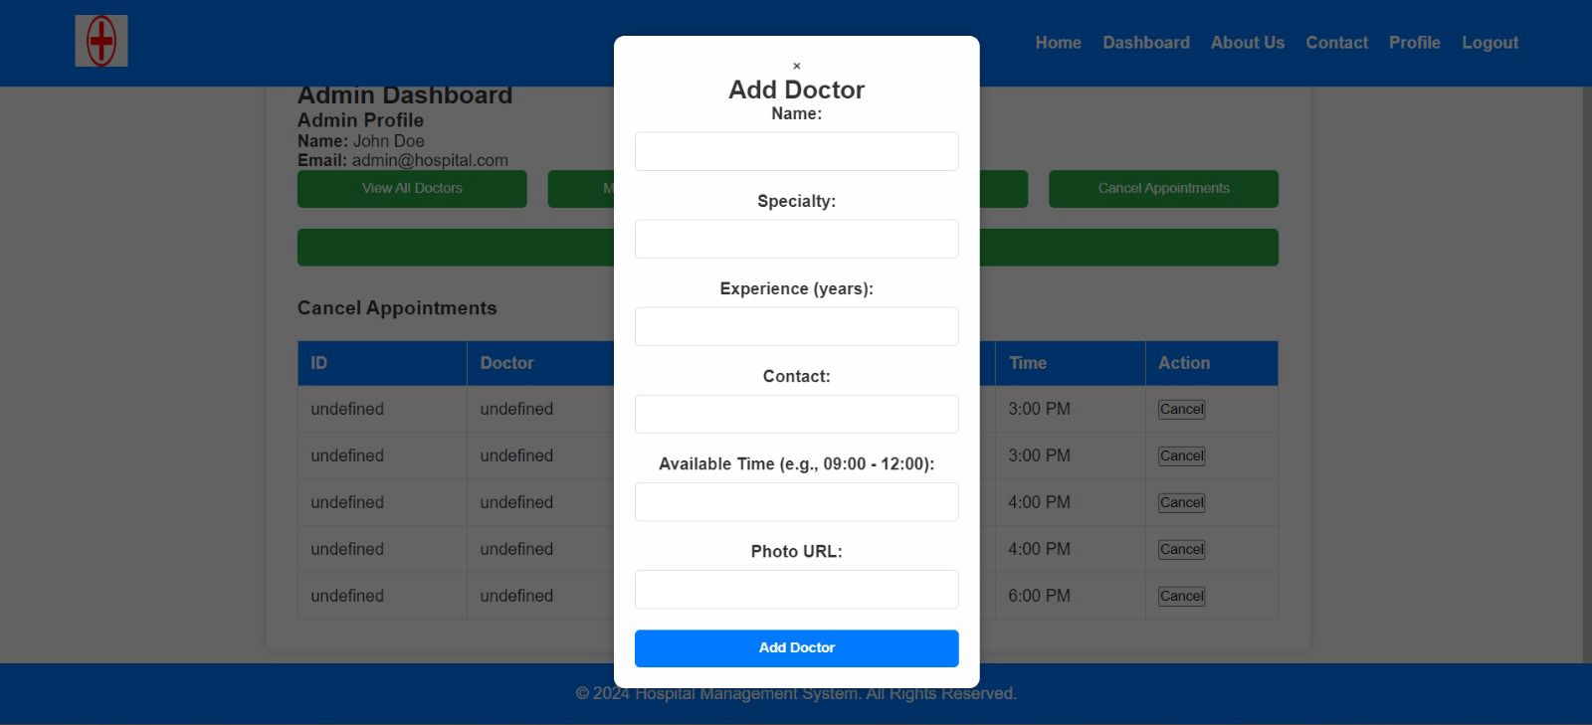
To add a doctor, admin should click on Add Doctor option, input all the necessary details and click on Add Doctor button.

Slide 33

Conclusion
The Hospital Management System automates key processes like user management, appointment scheduling, and medical record maintenance to enhance efficiency and improve patient care.
It features a user-friendly interface, secure data handling, and a scalable architecture, making it adaptable to the evolving needs of healthcare facilities.
The system allows administrators, doctors, and patients to easily manage information while ensuring compliance with industry standards.
By adopting this system, healthcare providers can focus on delivering quality care, leaving the system to manage administrative tasks.

Slide 34


